Slide 1
European Paediatric Neurology Society (EPNS)
Education, Promotion, Networking, and Science for Paediatric Neurology
International and independent non-profit making Society for physicians, health professionals, scientists, and students with research and/or clinical interest in Paediatric Neurology.
Mission: promote excellence in patient care, research, and education to improve the neurological outcome of children and young people in Europe and across the world.

Slide 2
European Paediatric Neurology Society (EPNS)
Education, Promotion, Networking, and Science for Paediatric Neurology
Our Structure
EPNS
4 main committees
PLUS, other sub committees
Such as
Guidelines Committee
Young EPNS
(YEPNS)
Science
& Research
Barbara Plecko
Education
& Training
Dana Craiu
Membership
& Finance
Jean-Pierre Lin
Michel Willemsen
Advocacy
& Collaboration
Anna Jansen
Committee of National Training Advisers
(C N A)

Slide 3
EPNS Membership numbers over the years

Slide 4
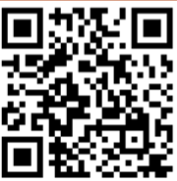
EPNS Science & Research
Upcoming events
EPNS Congress 8-12 July 2025 Munich, Germany
Theme: Building our alphabet
A for acute,
B for Brain, Health & Science
C for Chronic
PROGRAMME NOW LIVE
Registration OPEN! substantial discounts for EPNS members
https://epns-congress.com/

Slide 5
EPNS Advocating & Collaborating
MAJOR EPNS FOCUS
IGAP
Intersectoral Global Action Plan
on epilepsy and other neurological disorders
Addresses the challenges and gaps in providing care and services for people with epilepsy and other neurological disorders that exist worldwide and ensure a comprehensive, coordinated response across sectors.
Adopted in May 2022 with a
10-year action horizon by 192 countries

Slide 6
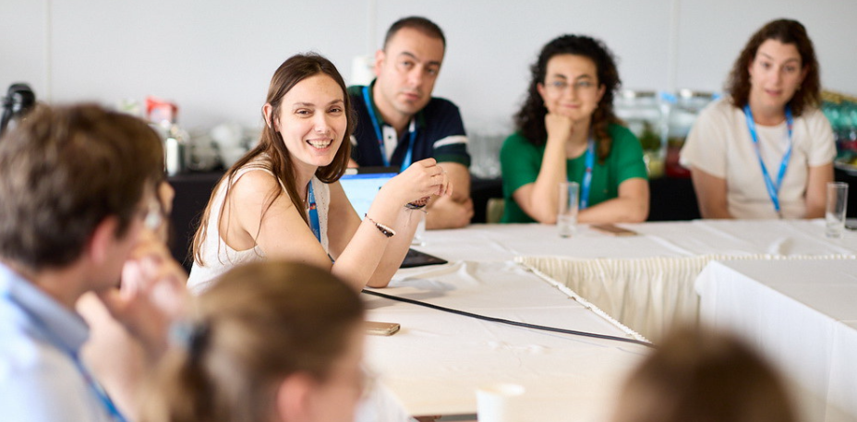
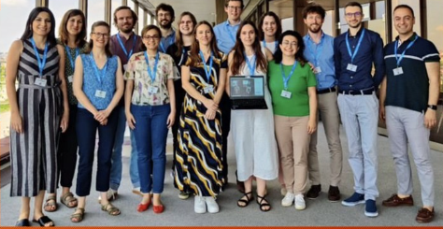
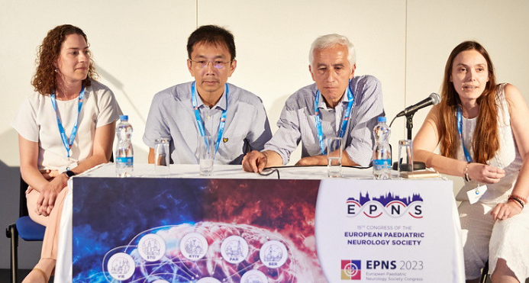
Young EPNS (YEPNS)
https://www.epns.info/young-epns-yepns/
Bringing together Young Professionals in Paediatric Neurology
5 YEPNS Working Groups:
Research & Career
Education & Clinic
Guidelines & Good Clinical Practice
Social Media & Networking
Climate change & Sustainability
YEPNS Chair:
Marietta Papadopoulou ☺

Slide 7
Educational EEG Club Journal Club Case Discussions
FREE 60-to-90-minute WEBINARS
FREE 60-to-90-minute WEBINARS
4 TYPES OF EPNS WEBINARS:
Topics of key interest to Child Neurologists
Featuring experts in the field
Journal Club & Case Discussion webinars hosted by the Young EPNS (YEPNS).
ALL ARE WELCOME TO JOIN THE EPNS WEBINARS
Fully paid up EPNS members
can access a recordings of all webinars via the EPNS Moodle.
https://www.epns.info/

Slide 8
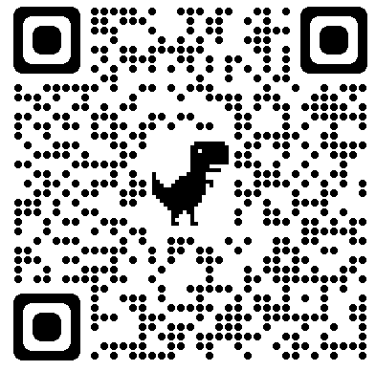
European Paediatric Neurology Society (EPNS)
Not an EPNS member? YOU ARE WELCOME
Join more than 2,500 members from Europe and beyond
EPNS Membership benefits, include:
European Journal of Paediatric Neurology (EJPN)
EPNS Moodle: learning resources, including all webinar recordings
An active and dynamic Young EPNS (YEPNS)
Affordable membership fees
Networking with like-minded professionals
Significantly reduced EPNS Congress registration fees
Scan above to join or email info@epns.info for more information

